Slide 1

Deep Audiobook Tuner: Background Music generation for audiobooks based on predicted sentiments.
St. Francis Institute of Technology
Department of Computer Engineering
7/22/2020

Slide 2
Group Members
Name | Roll No.
Daniel Lobo | 07
Jenny Dcruz | 16
Smita Deulkar | 19
Leander Fernandes | 20
Deep Audiobook Tuner

Slide 3
Content
Introduction
Literature Review
Problem definition and Proposed solution
Conclusion
References

Slide 4
Introduction
Musical scores are a vital part of any form of entertainment.
There has been major advancements in music generation
using artifical intelligence.
Audio books are preferred over reading books. Most audiobooks
do not include background music due to issues of copyright
infringements and licensing costs. Furthermore, it's not feasible
to create musical scores for every audio book.
At audiobook sites like Audible and LibriVox, these recordings
number in the hundreds of thousands

Slide 5
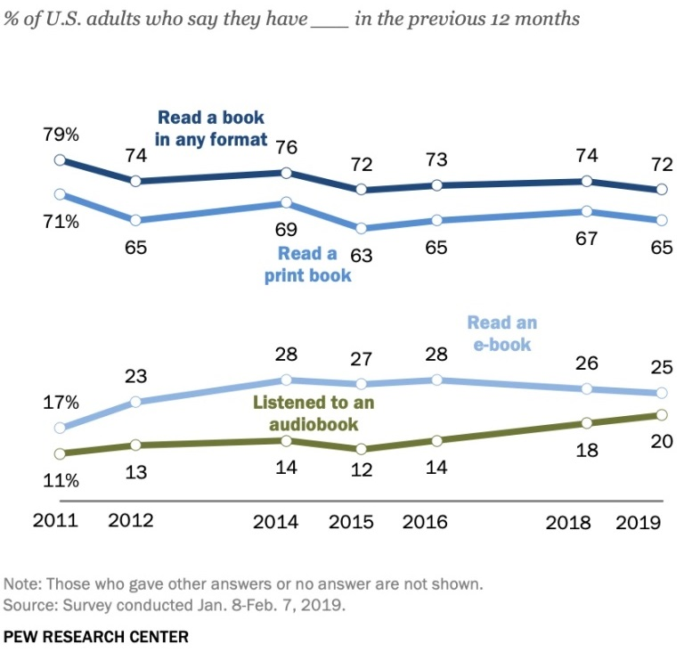
In 2013, users downloaded over 500 million hours of audiobooks from Audible alone, nearly 15% of Americans listened to an audiobook, and 14% of Americans listened to podcasts every month.As of 2019, the percentage of Americans listening to audio books has grown to 20% and shows a continuous growing trend.
Our project aims to create an easily accessible, efficient,and cost effective application to generate emotionally relevant musical scores for audio books.

Slide 6
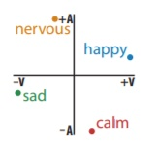
Literature Review
As cited in previous papers, a method was presented to extract sentiments from tect where each word has a valence and an arousal value where the valence dimension indicates whether an emotion is positive or negative, whereas arousal indicates the intensity of the emotion.
This paper focused on four emotions, happy, nervous, sad, and calm, because they almost evenly span the circumplex. As shown in the inset, we set their coordinates to (.95, .31), (−.31, .95),(−.95, −.31), and (−.95, .31), respectively, an equal distribution near their original locations [1]

Slide 7
Different methods of generating music as observed from the papers we studied are using SeqGAN,and LSTMs and RNN.For example, Sang-gil Lee and his team, used SeqGAN to generate polyphonic music sequences.[2]
In another paper, a model was created which would generate music with a given sentiment using LSTMs and Logistic Regression.[3]

Slide 8
Problem definition
Our project aims to develop a machine learning system that takes the scripts of an audio book as an input, analyzes the sentiments conveyed through the script and generates emotionally relevant music sequences.
As the the emotions coveyed through the script vary, the model will smoothly adapt to the emotional changes and provide a musical score that compliments the audiobook.

Slide 9
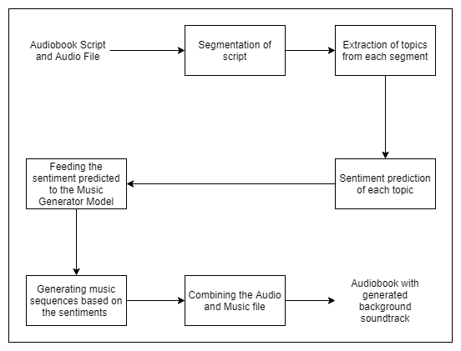
Proposed Solution

Slide 10
Our system consists of two models, sentiment analysis model and a music generation model.
The initial model with take an audio book file (script, audio) as it's input .
It will segment the script.
Individual segments are processed and topics are extracted from them.
The sentiment for each segment is analyzed from the topics extracted.
These sentiments are passed on as the input to the music generation model.
In this second model, music is generated and the sentiments are an important factor in adjusting the components of our model.
Finally, the music file is combined with the audio file that gives us our output which is an audio book with an emotionally relevant musical score.

Slide 11
Conclusion
High-quality narrations are integral to creating captivating digital content, but most audio books do not have background musical scores. The few that do have it are expensive as it a tedious task to create a sound track for it. Our proposed system can generate emotionally relevant scores which are cost effective, efficient and easily accessible to authors who want to add a soundtrack to their audiobook.

Slide 12
References
[1] Sang-gil Lee, Uiwon Hwang, Seonwoo Min, and Sungroh Yoon “Polyphonic music generation with sequence generative adversal networks” , Seoul National University, Seoul, Korea, 2018
[2] J. Salas, "Generating Music from Literature Using Topic Extraction and Sentiment Analysis" , in IEEE Potentials, vol. 37, no. 1, pp. 15-18, Jan.-Feb. 2018, doi: 10.1109/MPOT.2016.2550015.
[3]Lucas N. Ferreira, Jim Whitehead. “Learning to Generate
Music With Sentiment”, 20th International Society for Music Information Retrieval Conference, Delft, The Netherlands, 2019

Slide 13
Thank you

